Slide 1
Generative Adversarial Nets(GAN)

Slide 2
Outline
GAN Structure
Effect of GAN
DCGAN Structure
Effect of DCGAN

Slide 3
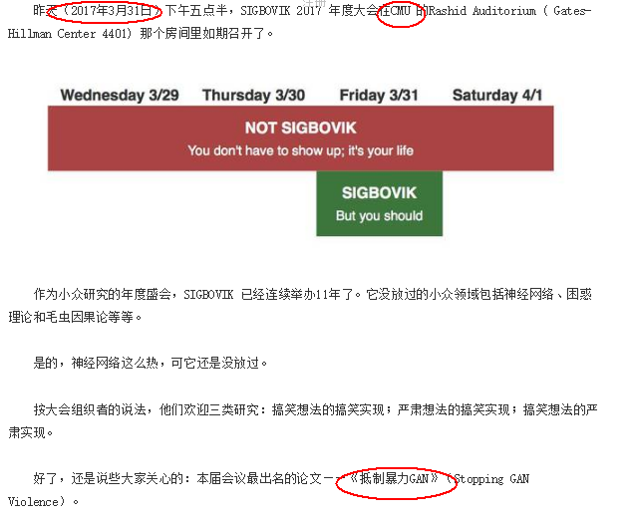

Slide 4
GAN
Paper:
《Generative Adversarial Nets》

Slide 5
Characteristics of GAN
Semi-supervised learning
generative model
can produce better generative samples
Theoretically, as long as the differential function can be used to construct D and G(D,G are two models in GAN), so it can be combined with the deep neural network to do deep generative model
…

Slide 6

GAN Structure
Z
Generator
G
G(z)
D
X
Discriminator
$$ρ_{（input∈X）[0,1]}$$
D(x) or D(G(z))
Notes:
Generator decorate z to cheat D
D discriminate the input is whether from x or z

Slide 7
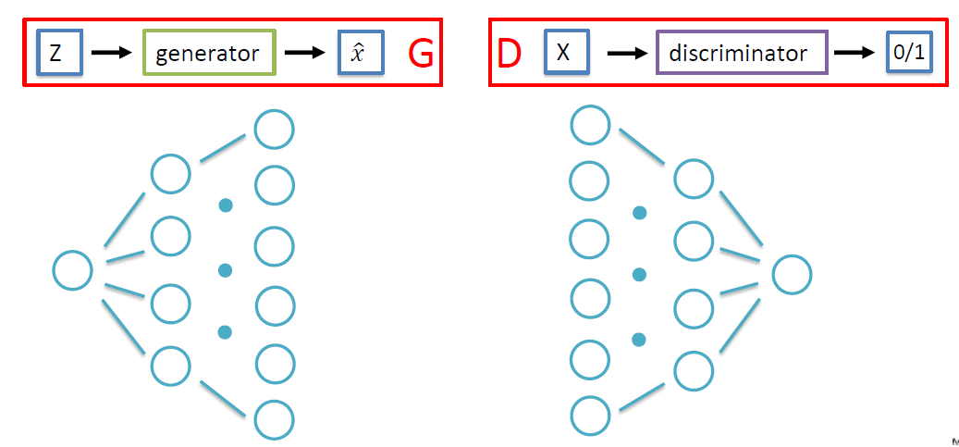
GAN Structure

Slide 8


GAN Structure
Objective Function:
$$\begin{matrix}min \\ G\end{matrix} \begin{matrix}max \\ D\end{matrix} ∁ \left(G,D\right)$$
${=E}_{(x\sim p_{data}(x))}\left[logD\left(x\right)\right] +$ $E_{(z\sim p_{z}(z))}\left[1−logD(G(z))\right]$
This objective function can achieve a global optimum for:
$p_{data}=p_{g(z)}$ , D(x)=D(g(z))=1/2
g(z)
Z
Generator
G
x
Discriminator
X
$$ρ_{（input∈X）}$$
D

Slide 9
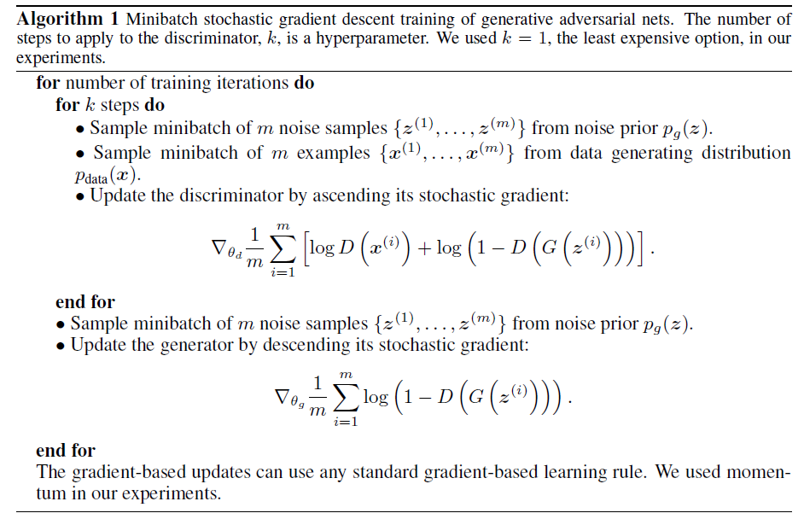

$$\begin{matrix}min \\ G\end{matrix} \begin{matrix}max \\ D\end{matrix} ∁ \left(G,D\right)$$
${=E}_{(x\sim p_{data}(x))}\left[logD\left(x\right)\right] +$ $E_{(z\sim p_{z}(z))}\left[1−logD(G(z))\right]$
Notes:
Train D: input (z, x)
Train G: input z

Slide 10
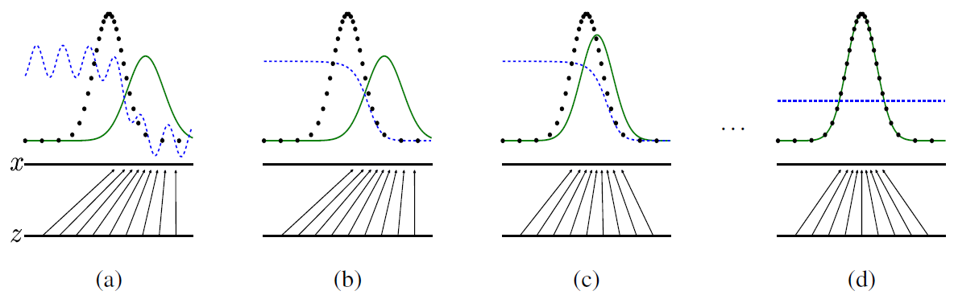
GAN Effect
Notes:
(a)At the initial state , the D can’t discriminate the input clearly
(b)We first train D to make it can discriminate the input clearly,
(c)Then we train G to make it can cheat the D more successfully
We repeat the serval epochs
Last the discriminator can not discriminate the input whether from x or from z
The probability produced by D (blue, dashed line)
Probability distribution of G(z) (green, solid line)
Probability distribution of X(black, dotted line)

Slide 11
DCGAN
Paper:
《Unsupervised Representation Learning With Deep Convolutional Generative Adversarial Networks》

Slide 12
DCGAN Structure

Slide 13

DCGAN Structure
Z
Generator
G(z)
(1.2, 4.5, 1.2)
X
Discriminator
$$ρ_{（input∈X）[0,1]}$$
D(x) or D(G(z))

Slide 14
DCGAN Effect
Notes:
Generated bedrooms after five epochs of training

Slide 15
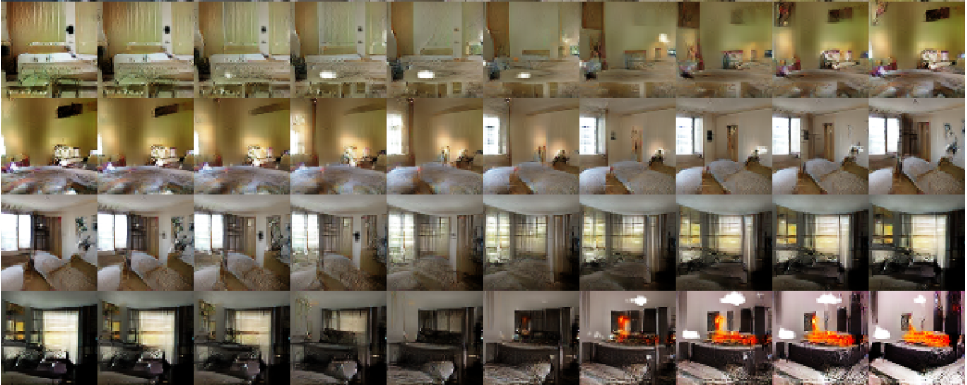
DCGAN Effect
Notes:
interpolation
smooth transitions

Slide 16
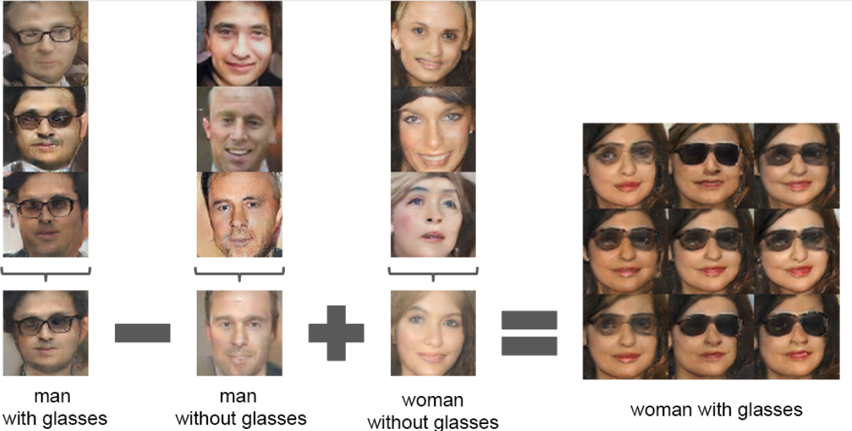
DCGAN Effect
Notes:
Vector arithmetic
For each column, the Z vectors of samples are averaged
The center sample on the right hand side is produce by feeding Y as input to the generator

Slide 17
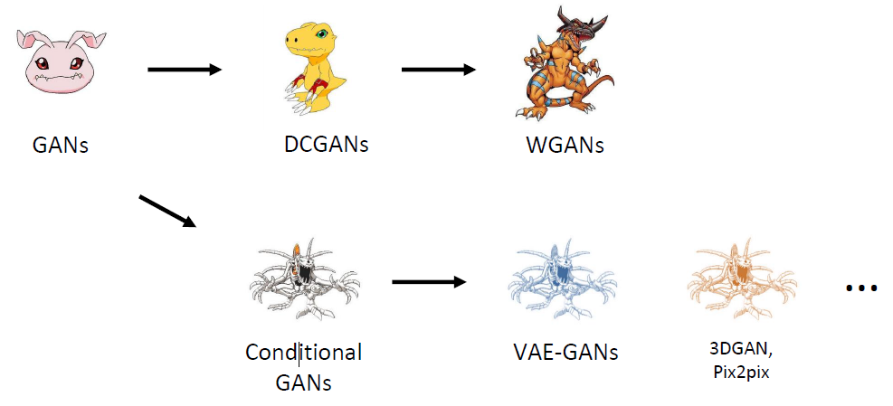
More GANs on the road

Slide 18
Thanks for your attention!

